Slide 1

Analysis of Netflix Content Distribution and Trends
Presented by: Sriram Joshi

Slide 2
Introduction
This project conducts a detailed analysis of Netflix's content distribution and viewer preferences to uncover strategic insights into the global streaming landscape.
By examining data on content type, directorial influence, geographical availability, and genre diversity, the study aims to explore how Netflix tailors its offerings to meet diverse audience demands and adapts to the dynamic entertainment industry.
The findings aim to contribute to the broader understanding of digital media trends and inform strategic decision-making within the streaming sector.

Slide 3
Objectives
Evaluate the types and distribution of content across different regions to understand Netflix's global content strategy.
Assess viewer preferences by analyzing popular genres and ratings to gauge audience trends.
Derive strategic insights into Netflix's content decisions to anticipate future trends in the streaming industry.

Slide 4
Dataset Information
The dataset contains detailed information about Netflix titles, including type, director, cast, release details, ratings, and descriptions. It categorizes each entry as either a Movie or TV Show, providing insights into Netflix's content distribution and viewer demographics.
show_id: A unique identifier for each title.
type: The type of the title, which can be either 'Movie' or 'TV Show'.
title: The name of the movie or TV show.
director: The director(s) of the movie or TV series episode.
cast: The list of main actors/actresses involved in the title.
country: The country or countries where the movie or TV show was produced.
date_added: The date the title was added to Netflix.
release_year: The year the title was originally released.
rating: The age certification or rating of the title.
duration: The length of the movie or the number of seasons in the case of TV shows.
listed_in: The genre(s) under which the title is listed.
description: A brief description of the plot of the title.

Slide 5
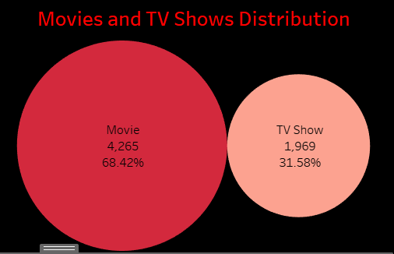
Distribution of Movies vs. TV Shows
Movies constitute 68.42% of the content, while TV shows make up 31.58%. This indicates a significant preference or strategic focus on movies over TV series in Netflix's catalog.

Slide 6
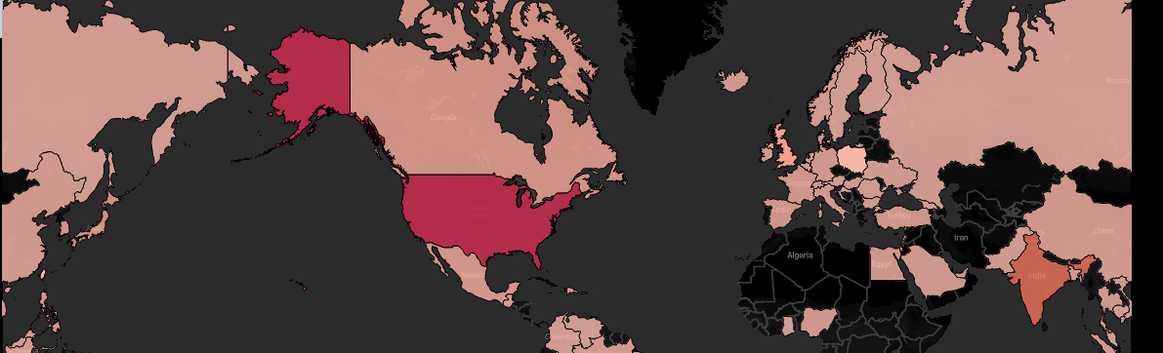
Geographical Insights
The map visualization reveals that the United States, India, and the United Kingdom are among the countries with the highest number of titles available.
The color intensity on the map correlates with the number of titles, showcasing a strong presence in North America and Europe.

Slide 7
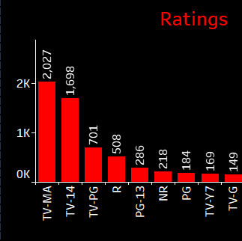
Ratings Analysis
The most common ratings are TV-MA (Mature Audiences) and TV-14 (Parents Strongly Cautioned), which suggests that a large portion of Netflix content is aimed at older teenagers and adults.

Slide 8
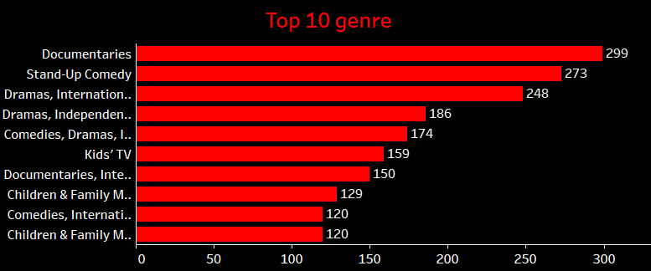
Popular Genres
Documentaries, stand-up comedies, and dramas are the most common genres. Documentaries top the list, which may indicate a strategic push for educational and real-world content.

Slide 9
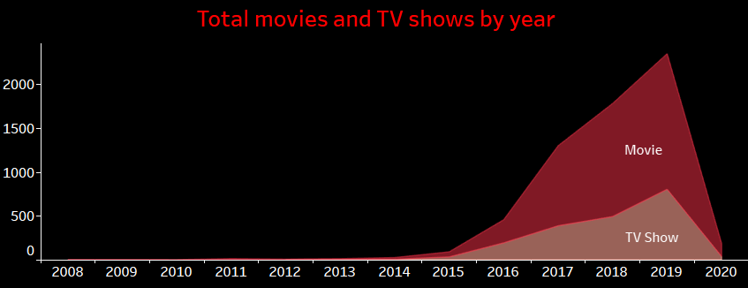
Content Release Trends
There's a noticeable increase in the number of titles added each year, peaking in 2018.
The growth trend in the content library aligns with Netflix's expansion into new markets and increased investment in original content.

Slide 10
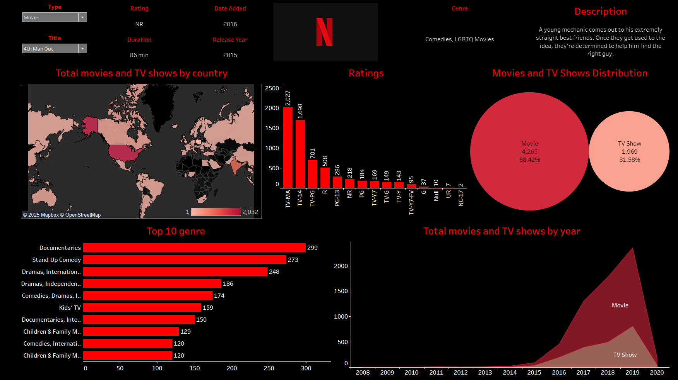
Final Dashboard

Slide 11
Recommendations based on analysis
Expand TV Series Production: Considering the current catalog is heavy on movies, Netflix could consider balancing this with more TV series to cater to audiences who prefer episodic content.
Focus on Emerging Markets: Enhancing content offerings in rapidly growing markets like India could capitalize on regional growth potential.
Invest in Diverse Genres: While documentaries are popular, investing in other genres like sci-fi or fantasy could attract different viewer segments.

Slide 12

Thank You

